Slide 1
IoT-Based Cold Chain Temperature Monitoring System

Slide 2
Problem & Objective
Cold chain logistics require strict temperature control between 2°C and 8°C
Temperature deviations can cause spoilage of food and medical products
Traditional monitoring systems lack real-time visibility and alerts
Delayed detection of faults increases operational and financial risks
Objective is to design a real-time automated monitoring solution
System provides continuous tracking, alerts, and actionable insights

Slide 3
System Architecture
The system is designed as a complete end-to-end IoT data pipeline
Sensor data is generated using a simulator representing real devices
MQTT protocol enables lightweight and real-time communication
Subscriber processes, validates, and enriches incoming data
InfluxDB stores high-frequency time-series sensor data efficiently
Streamlit dashboard visualizes data and applies anomaly detection

Slide 4
Device & Processing Layer
Three vehicles (V001, V002, V003) simulate real cold-chain transport
Each vehicle produces temperature, humidity, zone, and timestamp data
Zones include warehouse, transit, and delivery to reflect real conditions
Faults such as spikes, delays, duplicates, and dropouts are injected
Processing layer validates data and removes invalid or duplicate records
Alerts are triggered when temperature goes outside the safe 2–8°C range

Slide 5
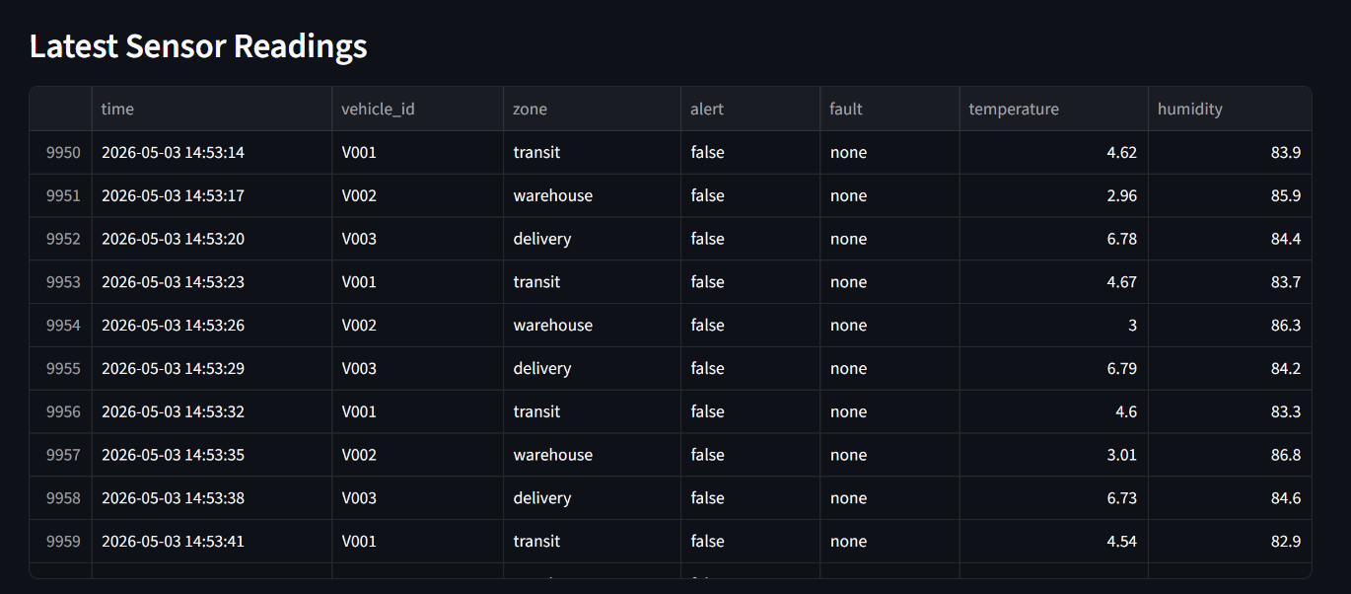
Storage & Key Metrics
InfluxDB is used to store time-series sensor data efficiently
The system successfully generated and stored over 10,000 records
Data is collected from 3 vehicles across 3 operational zones
A total of 133 cold chain alerts were detected during monitoring
Database supports fast querying and real-time data retrieval
Data can also be exported for further analysis and reporting

Slide 6
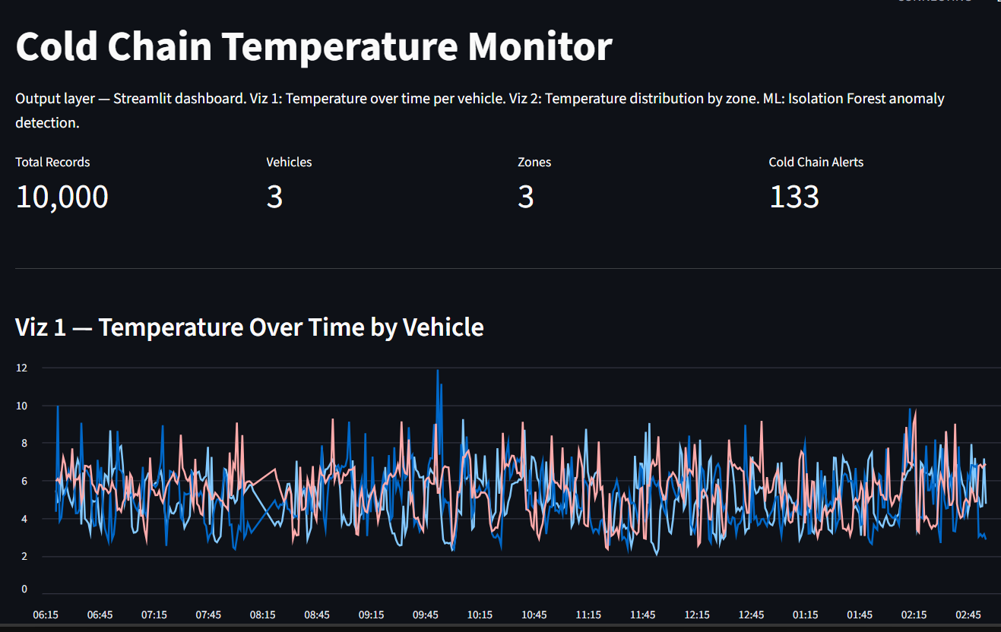
Visualization 1: Temperature Trends
Line chart displays temperature variations over time for each vehicle
Helps monitor real-time behavior of temperature during transportation
Multiple vehicles are tracked simultaneously in a single view
Sudden spikes or drops can be visually identified easily
Data is updated continuously to reflect real-time changes
Supports operational monitoring and quick decision-making

Slide 7
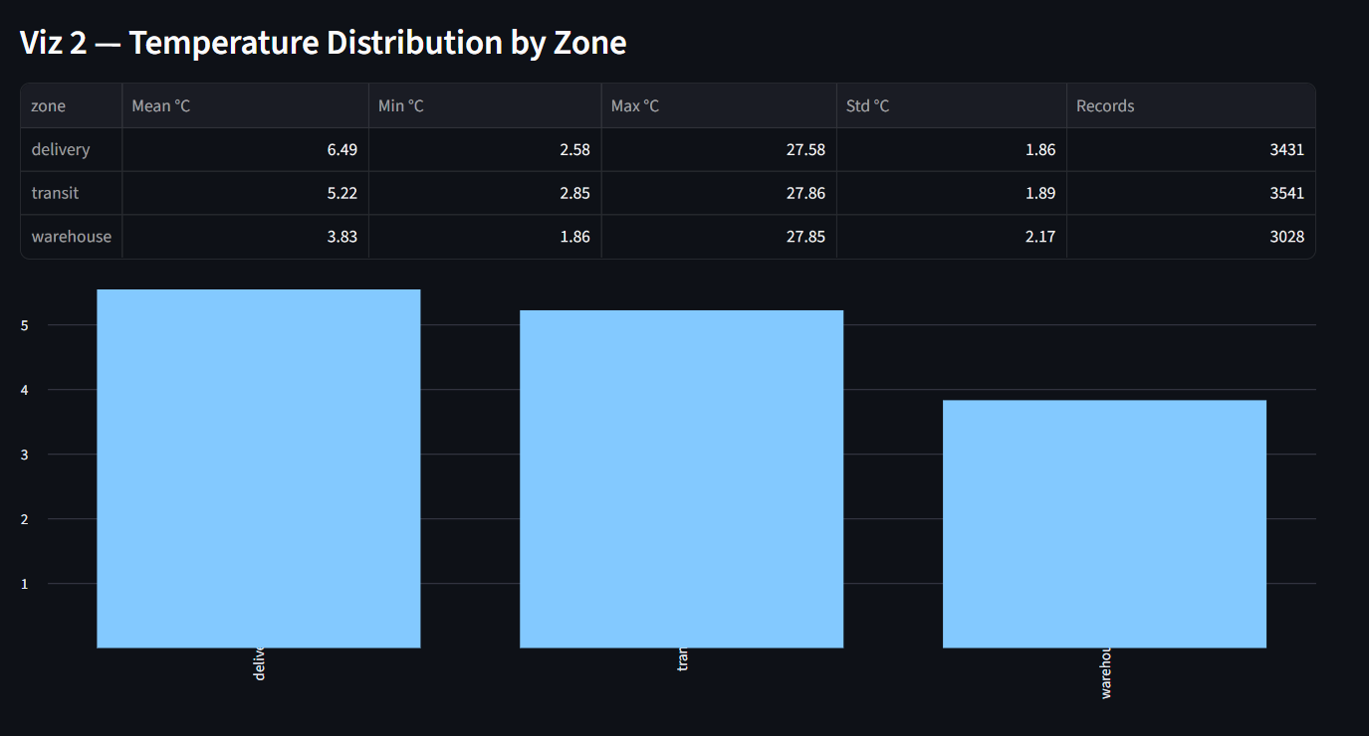
Visualization 2: Zone Analysis
Bar chart and table show temperature distribution across different zones
Delivery zone has an average temperature of approximately 6.49°C
Transit zone maintains around 5.22°C on average
Warehouse shows a lower average temperature of about 3.83°C
Variation in min and max values highlights possible anomalies or spikes
This analysis helps compare performance across operational stages

Slide 8
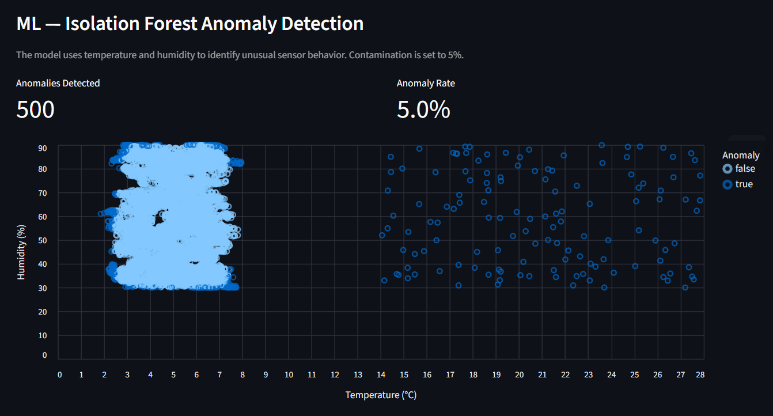
Machine Learning & Conclusion
Isolation Forest algorithm is used for anomaly detection
Model analyzes temperature and humidity patterns for abnormal behavior
A total of 500 anomalies were detected from the dataset
The anomaly rate is approximately 5 percent of all records
System successfully identifies unusual sensor readings in real time
The solution is scalable and can be extended to real-world deployments

